Slide 1
Software Architecture
Module 5
Techniques in a typical layered Architecture/ ATAM
Harvinder S Jabbal
SEZG651/SSZG653 Software Architectures

Slide 2
Architectural Structures and Views
Harvinder S Jabbal
SSZG653 Software Architectures

Slide 3
Contents
Typical layers in Layered architecture
Techniques used in different layers

Slide 4
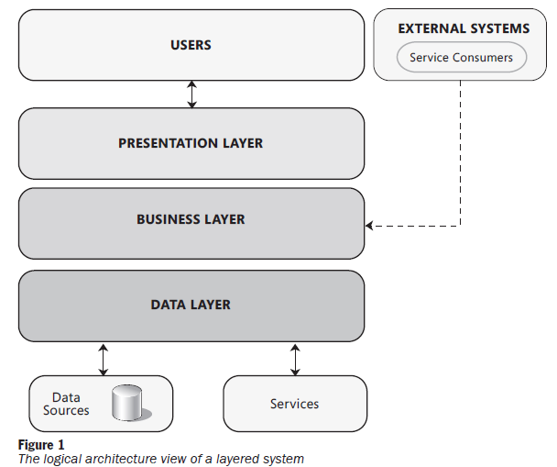
Typical layered architecture

Slide 5

Example of layers in Judiciary system
Citizens & Lawyers
Judges, Court staff
LAN
Firewall
Presentation layer
Case creation screen
Judgement screen
Presentation layer
Case creation
Case scheduling
Case proceedings
Case judgement
Business layer
Generic SMS client
Airtel adaptor
Airtel SMS system
Workflow engine
Vodafone adaptor
Vodafone SMS system
Data access layer
Case DAO
Proceedings
DAO
Schedule DAO
Users
DAO
DB Connections
Firewall
DB server

Slide 6
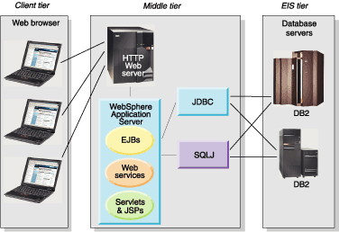
Typical layered architecture

Slide 7
Benefits of layered architecture (The "How")
"Separation of Concerns" principle.
  Why we use layers (maintainability, scalability).
The Presentation Layer
  Focus on the User Interface (UI) and User Experience (UX).
  Technologies like React, Angular, and mobile interfaces that handle user input.
The Business/Logic Layer
  This is the "heart" of the application. It handles data validation, business rules, and processing.
The Service Layer
  Role of APIs and Orchestration. Services act as a bridge between the business logic and external consumers.
The Data Access Layer (DAL)
  Focus on persistence. Object-Relational Mapping (ORM), database connections, and the abstraction of data storage.

Slide 8
Characteristics & benefits
Clearly defined functional layers (separation of concerns)
Loose coupling
Reusable lower layer components
Exchangeable parts

Slide 9
Techniques used in different layers

Slide 10
Presentation layer techniques
Cache frequently used data such as Product catalog (Client side caching vs Server side caching)
Use asynchronous communication between UI & Webserver to update parts of the web page without loading the whole web page (ex. AJAX)
Different rendering for different form-factors: Responsive design

Slide 11
Client side caching vs Server side caching
Client-side caching: Here we store frequently used data in the browser of the client machine – example user preference such as payment method, delivery address, etc.
Server-side caching: Here we store frequently used data needed by different back-end modules on the server-side – example: Product codes and description, promotions, etc.
Combination: In practice, a combination the above 2 techniques is used.

Slide 12
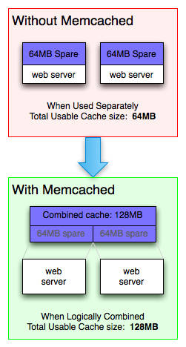
Memcached
memcached is a high-performance, distributed memory object caching system, generic in nature, but originally intended for use in speeding up dynamic web applications by alleviating database load.
You can think of it as a short-term memory for your applications.
memcached allows you to take memory from parts of your system where you have more than you need and make it accessible to areas where you have less than you need.

Slide 13
Asynchronous communication with web server
Example use cases:
Show product list depending on the product category selected by user
Validating a user input such as loan amount - whether it is within permissible limits, depending on user profile
Displaying a chat panel
Reloading Captcha

Slide 14
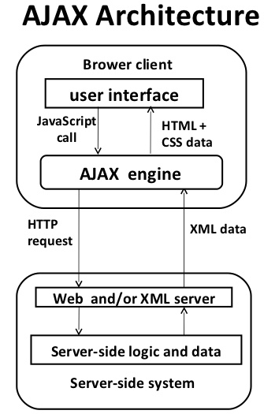
Asynchronous communication with web server
AJAX stands for Asynchronous JavaScript and XML.
AJAX is a technique for creating better, faster, and more interactive web applications with the help of XML, HTML, CSS, and Java Script.
Some famous web applications that use AJAX:
Google Maps (Drag entire map)
Google Suggest (Google suggests as you type)

Slide 15

Responsive web design: Examples
Notice how the layout changes depending on screen size
Responsive web design is an approach that renders web pages well on a variety of devices or screen sizes.

Slide 16
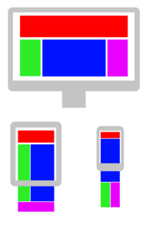
Consider different form factors – Use Responsive design
Ref: Wikipedia
Flexible grids
Allows varying layout depending on screen size
HTML5 and CSS3 help in specifying the display arrangement

Slide 17
Presentation layer
Have you used any other techniques in Presentation layer?

Slide 18
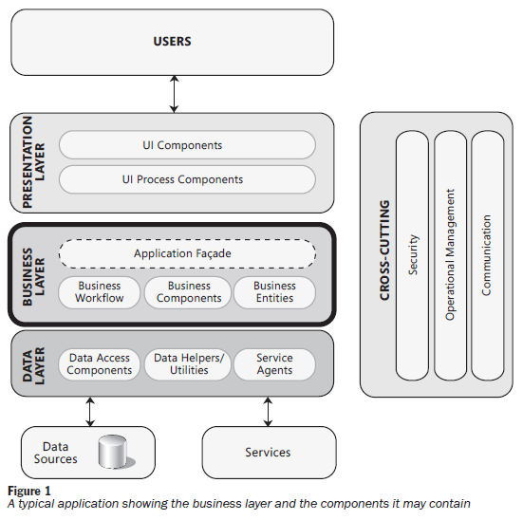
Business layer

Slide 19
Business layer techniques
Use Application façade to hide internal modules
Implement session management
Use Work flow engine, Rules engine, etc. for modifiability

Slide 20
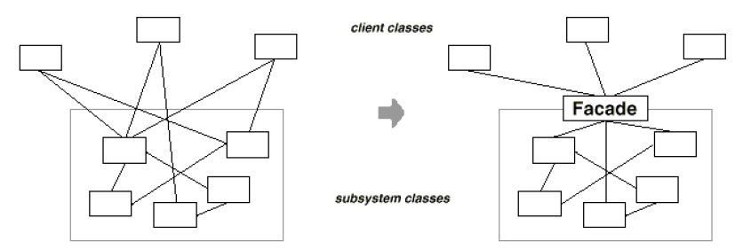
Facade: Making sub-system easier to use
Intent:
Provide a unified interface to a set of interfaces in a subsystem.
Facade defines a higher-level interface that makes the subsystem easier to use.
It typically involves a single wrapper class which contains a set of members required by client.

Slide 21
Example of Application façade: Flight booking
Booking_User_Interace
Get_flt_details
Client
Booking_Engine
Get_flt_details
Server
Schedule
Get_flt_list
Seat Inventory
Get_seat_availability
Pricing
Get_flt_price

Slide 22

Session management
Instance 1
Web Server
Req #1
Add to Cart
Req #1
Browser
Session state
Prod id1. Qty
Prod id 2, Qty
Req #2
Instance 2
Add to Cart
Client based state mgmt. (cookies)
Server based session mgmt. (persistent)
Req #2

Slide 23
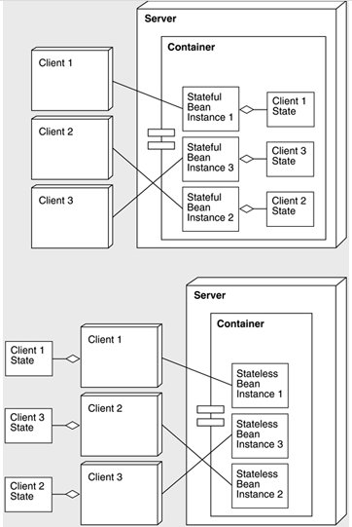
EJB: Stateless & Stateful session beans
J2EE server
EJB Container
Stateful session Bean: All requests from a Client goes to the same instance of the Bean.
Bean maintains the state of the session
J2EE server
EJB Container
Stateless session Bean: Subsequent request from a client to a Bean may go to another instance of the Bean
Hence Client needs to main the state of the session

Slide 24
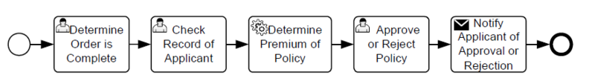
Work flow engine
Insurance policy processing
Example Activities
Once an activity is completed, the engine invokes the next step in the process
The next step / activity could be a manual one or an automated one
Popular engines: BizTalk Server, Oracle BPEL processor, IBM WebSphere Process Server

Slide 25
Aspect oriented design for cross cutting concerns
Aspect Oriented design aims to encapsulate cross-cutting concerns into aspects (enhancing modularity)
Examples of aspects:
Logging & instrumentation
Auditing: Who is doing what
Caching
Security

Slide 26
Aspect Oriented Design
Different aspects of the system
They cut across layers
Modules in different layers call the modules in the cross-cutting sub-system at different points in time

Slide 27
Logging & instrumentation
Log actionable information such as errors
  “Database is unavailable”
  Information useful to diagnose errors
Logging is expensive. Log only the most essential data
Instrumentation helps in understanding the usage & behaviour of the system
  Request rate
  Error rate
  Duration of requests
  Queue length
Ref: https://peter.bourgon.org/blog/2016/02/07/logging-v-instrumentation.html

Slide 28
Business layer
We saw:
Façade
Session mangement
Work flow engine
Aspect oriented design
Have you used any other technique in Business layer?

Slide 29
Data layer: Prominent techniques used
Use DB connection pool, if there are too many users
Use multiple copies of data for faster access
Use transactions to achieve atomicity
Use Object - Relational mapping
Use stored procedures to improve performance
Use parameterized SQL queries to reduce SQL injection attacks

Slide 30
Object-Relational mapping
Helps in mapping objects in our program to database table
Hibernate is a framework that provides an Object/Relational Mapping (O/RM)

Slide 31
SQL Injection attacks
Do not concatenate user entered string to SQL string
  Malicious input can result in the following:
  SELECT product-data FROM table WHERE product-name = ‘Toothpaste’ OR ‘x’ = ‘x’;
  This will return all product data
Use parameterized SQL queries
  SELECT product-data FROM table WHERE product-name = ?
  ? Is a parameter which contains the value entered by user

Slide 32
Data layer
Have you used any other technique in Data layer?

Slide 33
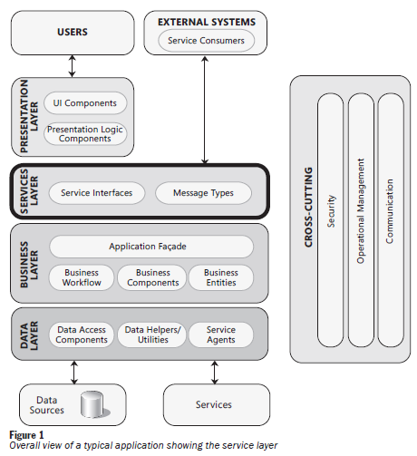
Services layer
Get Balance (A/c #)
Provides services to external systems
Example: A bank may provide following services to external systems:
Get Balance
Request chequebook

Slide 34
Service layer
Situations that need to be handled by service layer
Handle same request coming twice
Handle message coming out of sequence
Handle communication failure (using retry mechanism or by queuing work and sending once communication is restored)

Slide 35
Question
Have you used any other techniques in a layered architecture?

Slide 36
Exercise 1
What are some of the components of Departure Control System in
  Presentation layer
  Business layer
  Data layer
  Service layer

Slide 37
Exercise: Identify components in different layers of DCS

Slide 38
Exercise 2
What software mechanism will you use to improve the performance in the following situation:
One of the frequently used screens in Aadhaar system is citizen registration.
This screen has a fields “State” and “District” and “Town”, which are Drop-down fields
It takes time to loading this screen due to the large number of states, districts and towns in India

Slide 39
Solution
Cache states, districts and towns in the backend
Use AJAX for dynamic loading of districts and towns

Slide 40
Exercise 3:
Suppose you are developing a hotel reservation system.
You want to provide is an interface to externals applications such as Makemytrip.com, to inquire about availability of rooms and book rooms.
What layer would you build and what will be the component (s) in that layer?

Slide 41
Answer
Services layer is needed to provide interface to external systems.
This layer will have components such as
  Get room availability (from date, to date) return (# rooms available by type of room)
  Reserve room (# of rooms, type of room, from date, to date) Return (Success / Failure)

Slide 42
Exercise 4
Suppose you are building a complex logistics system for a shipping & container company
Users wanting to send goods via containers will login to the system and place their requests
A number of modules need to be called for this:
  Find out the nearest location of an empty container
  Find a the best transporter to pick up the goods
  Find a ship that is scheduled leave to the desired destination and has spare capacity to load the container
As an architect you want to hide these modules from the client layer.
What technique will you use and in which layer?

Slide 43
Answer
In the Business layer, provide a unified API – façade - to place a shipping request
The façade will in turn make use of modules to search for appropriate container, appropriate transporter, appropriate ship, etc.

Slide 44
Appendix

Slide 45
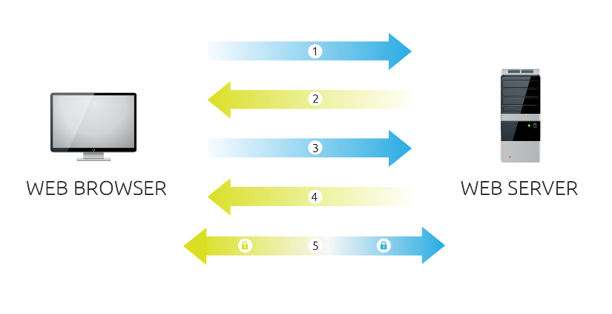
SSL
Browser connects to a web server (website) secured with SSL (https). Browser requests that the server identify itself.
Server sends a copy of its SSL Certificate, including the server’s public key.
Browser checks the certificate root against a list of trusted CAs and that the certificate is unexpired, unrevoked, and that its common name is valid for the website that it is connecting to. If the browser trusts the certificate, it creates, encrypts, and sends back a symmetric session key using the server’s public key.
Server decrypts the symmetric session key using its private key and sends back an acknowledgement encrypted with the session key to start the encrypted session.
Server and Browser now encrypt all transmitted data with the session key.

Slide 46
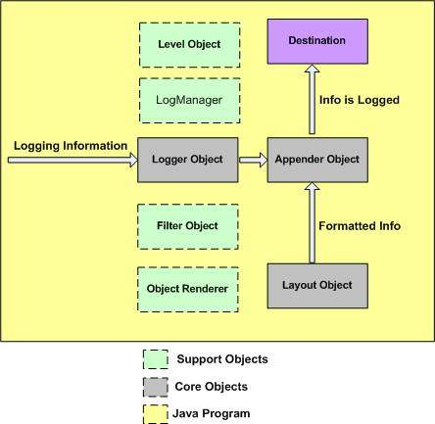
Logging: Apache Log4j
Database, file, console, UNIX Syslog, etc.
Logging is an important component of the software development.
A well-written logging code offers quick debugging, easy maintenance, and structured storage of an application's runtime information.
Logging does have its drawbacks also. It can slow down an application.
capturing logging information
format logging information

Slide 47

SSL
Browser requests that the server identify itself.
Server sends a copy of its SSL Certificate
Browser checks the certificate. and sends back a symmetric session key
Server sends back an acknowledgement.
Server and Browser now encrypt all transmitted data with the session key.

Slide 48
IPSec – Internet Protocol Security
IPSec is an Internet Engineering Task Force (IETF) standard suite of protocols that provides data authentication, integrity, and confidentiality as data is transferred between communication points across IP networks.
IPSec provides data security at the IP packet level.

Slide 49
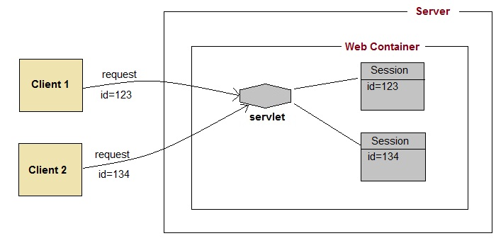
Session management
A web session is a sequence of network HTTP request and response transactions associated to the same user.
Modern and complex web applications require the retaining of information or status about each user for the duration of multiple requests.

Slide 50
Architecture Evaluation through
Architecture Trade off Analysis Method
Reference Chapter 21
Software Architecture in Practice
Third Edition
Len Bass
Paul Clements
Rick Kazman
Harvinder S Jabbal
SEZG651/SSZG653 Software Architectures

Slide 51
SEZG651/ SSZG653
Software Architectures
Module 5-CS 07

Slide 52
Chapter Outline
Evaluation Factors
The Architecture Tradeoff Analysis Method (ATAM)
Lightweight Architecture Evaluation
Summary

Slide 53
Evaluation Factors

Slide 54
Three Forms of Evaluation
Evaluation by the designer within the design process.
Evaluation by peers within the design process.
Analysis by outsiders once the architecture has been designed.

Slide 55
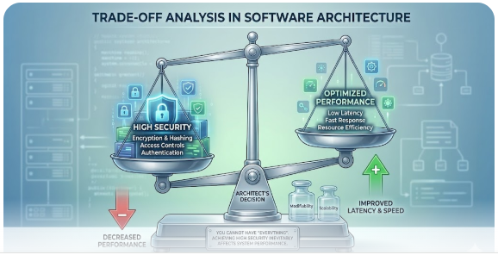
Architecture Evaluation (The "Why")
Why Evaluate Architecture?
A "fail early" philosophy. The necessity of ATAM.
ATAM is a process to identify risks and trade-offs.
Trade-off Analysis You cannot have "everything." For example, increasing Security often decreases Performance.

Slide 56
Evaluation by the Designer
Every time the designer makes a key design decision or completes a design milestone, the chosen and competing alternatives should be evaluated.
Evaluation by the designer is the “test” part of the “generate-and-test” approach to architecture design.
How much analysis? This depends on the importance of the decision. Factors include:
The importance of the decision. The more important the decision, the more care should be taken in making it and making sure it’s right.
The number of potential alternatives. The more alternatives, the more time could be spent in evaluating them. Try to eliminate alternatives quickly so that the number of viable potential alternatives is small.
Good enough as opposed to perfect. Many times, two possible alternatives do not differ dramatically in their consequences. In such a case, it is more important to make a choice and move on with the design process than it is to be absolutely certain that the best choice is being made. Again, do not spend more time on a decision than it is worth.

Slide 57
Peer Review
Architectural designs can be peer reviewed, just as code can.
A peer review can be carried out at any point of the design process where a candidate architecture, or at least a coherent reviewable part of one, exists.
Allocate at least several hours and possibly half a day.

Slide 58
Peer Review Steps
Step 1
The reviewers determine a number of quality attribute scenarios to drive the review. These scenarios can be developed by the review team or by additional stakeholders.
The architect presents the portion of the architecture to be evaluated. The reviewers individually ensure that they understand the architecture. Questions at this point are specifically for understanding.
For each scenario, the designer walks through the architecture and explains how the scenario is satisfied. The reviewers ask questions to determine (a) that the scenario is, in fact, satisfied and (b) whether any of the other scenarios being considered will not be satisfied.
Potential problems are captured. Real problems must either must be fixed or a decision must be explicitly made by the designers and the project manager that they are willing to accept the problems and its probability of occurrence.
Step 2
Step 3
Step 4

Slide 59
Analysis by Outsiders
Outside evaluators can cast an objective eye on an architecture.
“Outside” is relative; this may mean
outside the development project
outside the business unit where the project resides but within the same company
outside the company altogether.
Outsiders are chosen because they possess specialized knowledge or experience, or long experience successfully evaluating architectures.
Managers tend to be more inclined to listen to problems uncovered by an outside team.
An outside team tends to be used to evaluate complete architectures.

Slide 60
Contextual Factors for Evaluation
What artifacts are available?
Who sees the results?
Who performs the evaluation?
Which stakeholders will participate?
What are the business goals?
To perform an architectural evaluation, there must be an artifact that describes the architecture.
Some evaluations are performed with the full knowledge and participation of all of the stakeholders. Others are performed more privately.
Evaluations can be carried out by an individual or a team.
The evaluation process should provide a method to elicit the goals and concerns that the important stakeholders have regarding the system. Identifying the individuals who are needed and assuring their participation in the evaluation is critical.
The evaluation should answer whether the system will satisfy the business goals.

Slide 61
The Architecture Tradeoff Analysis Method

Slide 62
The Architecture Tradeoff Analysis Method
The Architecture Tradeoff Analysis Method (ATAM) has been used for over a decade to evaluate software architectures in domains ranging from automotive to financial to defense.
The ATAM is designed so that evaluators need not be familiar with the architecture or its business goals, the system need not yet be constructed, and there may be a large number of stakeholders.

Slide 63
Participants in the ATAM
The evaluation team.
External to the project whose architecture is being evaluated.
Three to five people; a single person may adopt several roles in an ATAM.
They need to be recognized as competent, unbiased outsiders.
Project decision makers.
These people are empowered to speak for the development project or have the authority to mandate changes to it.
They usually include the project manager, and if there is an identifiable customer who is footing the bill for the development, he or she may be present (or represented) as well.
The architect is always included – the architect must willingly participate.
Architecture stakeholders.
Stakeholders have a vested interest in the architecture performing as advertised.
Stakeholders include developers, testers, integrators, maintainers, performance engineers, users, builders of systems interacting with the one under consideration, and, possibly, others.
Their job is to articulate the specific quality attribute goals that the architecture should meet.
Expect to enlist 12 to 15 stakeholders for the evaluation of a large enterprise-critical architecture.

Slide 64
ATAM Evaluation Team Roles
Role
Responsibilities
Team leader
Sets up the evaluation; coordinates with client, making sure client’s needs are met; establishes evaluation contract; forms evaluation team; sees that final report is produced and delivered (although the writing may be delegated)
Evaluation leader
Runs evaluation; facilitates elicitation of scenarios; administers scenario selection/prioritization process; facilitates evaluation of scenarios against architecture; facilitates on-site analysis
Scenario scribe
Writes scenarios on flipchart or whiteboard during scenario elicitation; captures agreed-on wording of each scenario, halting discussion until exact wording is captured
Proceedings scribe
Captures proceedings in electronic form on laptop or workstation: raw scenarios, issue(s) that motivate each scenario (often lost in the wording of the scenario itself), and resolution of each scenario when applied to architecture(s); also generates a printed list of adopted scenarios for handout to all participants
Questioner
Raises issues of architectural interest, usually related to the quality attributes in which he or she has expertise

Slide 65
Outputs of the ATAM
1
A concise presentation of the architecture. The architecture is presented in one hour
2
Articulation of the business goals. Frequently, the business goals presented in the ATAM are being seen by some of the assembled participants for the first time and these are captured in the outputs.
3
Prioritized quality attribute requirements expressed as quality attribute scenarios. These quality attribute scenarios take the form described in Chapter 4.
4
A set of risks and nonrisks.
A risk is defined as an architectural decision that may lead to undesirable consequences in light of quality attribute requirements.
A nonrisk is an architectural decision that, upon analysis, is deemed safe.
The identified risks form the basis for an architectural risk mitigation plan.

Slide 66
Outputs of the ATAM
5.
A set of risk themes. When the analysis is complete, the evaluation team examines the full set of discovered risks to look for overarching themes that identify systemic weaknesses in the architecture or even in the architecture process and team. If left untreated, these risk themes will threaten the project’s business goals.
6.
Mapping of architectural decisions to quality requirements. For each quality attribute scenario examined during an ATAM, those architectural decisions that help to achieve it are determined and captured.
7.
A set of identified sensitivity and tradeoff points. These are architectural decisions that have a marked effect on one or more quality attributes.

Slide 67
Intangible Outputs
There are also intangible results of an ATAM-based evaluation. These include
a sense of community on the part of the stakeholders
open communication channels between the architect and the stakeholders
a better overall understanding on the part of all participants of the architecture and its strengths and weaknesses.
While these results are hard to measure,
they are no less important than the others and often are the longest-lasting.

Slide 68
Phases of the ATAM
Phase | Activity | Participants | Typical duration
0 | Partnership and preparation: Logistics, planning, stakeholder recruitment, team formation | Evaluation team leadership and key project decision-makers | Proceeds informally as required, perhaps over a few weeks
1 | Evaluation: Steps 1-6 | Evaluation team and project decision-makers | 1-2 days followed by a hiatus of 2-3 weeks
2 | Evaluation: Steps 7-9 | Evaluation team, project decision makers, stakeholders | 2 days
3 | Follow-up: Report generation and delivery, process improvement | Evaluation team and evaluation client | 1 week

Slide 69
Step 1: Present the ATAM
The evaluation leader presents the ATAM to the assembled project representatives.
This time is used to explain the process that everyone will be following, to answer questions, and to set the context and expectations for the remainder of the activities.
Using a standard presentation, the leader describes the ATAM steps in brief and the outputs of the evaluation.

Slide 70
Step 2: Present Business Drivers
Everyone involved in the evaluation needs to understand the context for the system and the primary business drivers motivating its development.
In this step, a project decision maker (ideally the project manager or the system’s customer) presents a system overview from a business perspective.
The presentation should describe the following:
The system’s most important functions
Any relevant technical, managerial, economic, or political constraints
The business goals and context as they relate to the project
The major stakeholders
The architectural drivers (that is, the architecturally significant requirements)

Slide 71
Step 3: Present the Architecture
The lead architect (or architecture team) makes a presentation describing the architecture.
The architect covers technical constraints such as operating system, hardware, or middleware prescribed for use, and other systems with which the system must interact.
The architect describes the architectural approaches (or patterns, or tactics, if the architect is fluent in that vocabulary) used to meet the requirements.
The architect’s presentation should convey the essence of the architecture and not stray into ancillary areas or delve too deeply into the details of just a few aspects.
The architect should present the views that he or she found most important during the creation of the architecture and the views that help to reason about the most important quality attribute concerns of the system.

Slide 72
Step 4: Identify Architectural Approaches
The ATAM focuses on analyzing an architecture by understanding its architectural approaches, especially patterns and tactics.
By now, the evaluation team will have a good idea of what patterns and tactics the architect used in designing the system.
They will have studied the architecture documentation
They will have heard the architect’s presentation in step 3.
The team should also be adept at spotting approaches not mentioned explicitly
The evaluation team simply catalogs the patterns and tactics that have been identified.
The list is publicly captured and will serve as the basis for later analysis.

Slide 73
Step 5: Generate Utility Tree
The quality attribute goals are articulated in detail via a quality attribute utility tree.
Utility trees serve to make the requirements concrete by defining precisely the relevant quality attribute requirements that the architects were working to provide.
The important quality attribute goals for the architecture under consideration were named in step 2.
In this step, the evaluation team works with the project decision makers to identify, prioritize, and refine the system’s most important quality attribute goals.
These are expressed as scenarios, which populate the leaves of the utility tree.
The scenarios are assigned a rank of importance (High, Medium, Low).

Slide 74
Step 6: Analyze Architectural Approaches
The evaluation team examines the highest-ranked scenarios one at a time; the architect is asked to explain how the architecture supports each one.
Evaluation team members—especially the questioners—probe for the architectural approaches that the architect used to carry out the scenario.
Along the way, the evaluation team documents the relevant architectural decisions and identifies and catalogs their risks, nonrisks, sensitivity points, and tradeoffs. Examples:
Risk: The frequency of heartbeats affects the time in which the system can detect a failed component. Some assignments will result in unacceptable values of this response.
Sensitivity point: The number of simultaneous database clients will affect the number of transactions that a database can process per second.
Tradeoff: The heartbeat frequency determines the time for detecting a fault. Higher frequency leads to better availability but consumes more processing time and communication bandwidth (potentially reducing performance).
These, in turn, may catalyze a deeper analysis.
The analysis is not meant to be comprehensive. The key is to elicit sufficient architectural information to establish a link between the architectural decisions made and the quality attribute requirements that need to be satisfied.

Slide 75
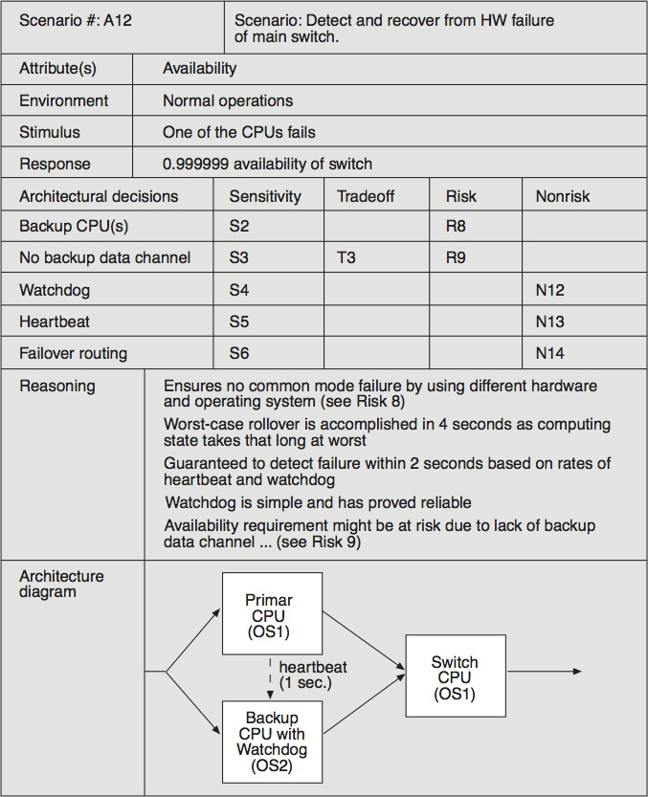
Example of an Analysis

Slide 76
Step 7: Brainstorm and Prioritize Scenarios
The stakeholders brainstorm scenarios that are operationally meaningful with respect to the stakeholders’ individual roles.
A maintainer will likely propose a modifiability scenario
A user will probably come up with a scenario that expresses useful functionality or ease of operation
A quality assurance person will propose a scenario about testing the system or being able to replicate the state of the system leading up to a fault.
The purpose of scenario brainstorming is to take the pulse of the larger stakeholder community: to understand what system success means for them.
Once the scenarios have been collected, they are prioritized by voting.
The list of prioritized scenarios is compared with those from the utility tree exercise.
If they agree, it indicates good alignment between what the architect had in mind and what the stakeholders actually wanted.
If additional driving scenarios are discovered—and they usually are—this may itself be a risk, if the discrepancy is large. This would indicate that there was some disagreement in the system’s important goals between the stakeholders and the architect.

Slide 77
Step 8: Analyze Architectural Approaches
In this step the evaluation team performs the same activities as in step 6, using the highest-ranked, newly generated scenarios.
The evaluation team guides the architect in the process of carrying out the highest ranked new scenarios.
The architect explains how relevant architectural decisions contribute to realizing each one.
This step might cover the top 5-10 scenarios, as time permits.

Slide 78
Step 9: Present Results
The evaluation team confers privately to group risks into risk themes, based on some common underlying concern or systemic deficiency.
For example, a group of risks about inadequate or out-of-date documentation might be grouped into a risk theme stating that documentation is given insufficient consideration.
A group of risks about the system’s inability to function in the face of various hardware and/or software failures might lead to a risk theme about insufficient attention to backup capability or providing high availability.
For each risk theme, the evaluation team identifies which of the business drivers listed in step 2 are affected.
This elevates the risks that were uncovered to the attention of management, who cares about the business drivers.

Slide 79
Step 9: Present Results
The collected information from the evaluation is summarized and presented to stakeholders.
The following outputs are presented:
The architectural approaches documented
The set of scenarios and their prioritization from the brainstorming
The utility tree
The risks discovered
The nonrisks documented
The sensitivity points and tradeoff points found
Risk themes and the business drivers threatened by each one

Slide 80
Lightweight Architectural Evaluation

Slide 81
Lightweight Architectural Evaluation
An ATAM is a substantial undertaking.
It requires some 20 to 30 person-days of effort from an evaluation team, plus even more for the architect and stakeholders.
Investing this amount of time makes sense on a large and costly project, where the risks of making a major mistake in the architecture are unacceptable.
We have developed a Lightweight Architecture Evaluation method, based on the ATAM, for smaller, less risky projects.
May take place in a single day, or even a half-day meeting.
May be carried out entirely by members internal to the organization.
Of course this lower level of scrutiny and objectivity may not probe the architecture as deeply.
Because the participants are all internal to the organization and fewer in number than for the ATAM, giving everyone their say and achieving a shared understanding takes much less time.
The steps and phases of a Lightweight Architecture Evaluation can be carried out more quickly.

Slide 82
Typical Agenda: 4-6 Hours
Step | Time | Notes
1. Present the ATAM | 0 hours | Participants already familiar with process.
2. Present business drivers | 0.25 hours | The participants are expected to understand the system and its business goals and their priorities. A brief review ensures that these are fresh in everyone’s mind and that there are no surprises.
3. Present architecture | 0.5 hours | All participants are expected to be familiar with the system. A brief overview of the architecture, using at least module and C&C views, is presented. 1-2 scenarios are traced through these views.
4. Identify architectural approaches | 0.25 hours | The architecture approaches for specific quality attribute concerns are identified by the architect. This may be done as a portion of step 3.
5. Generate QA utility tree | 0.5- 1.5 hours | Scenarios might exist: part of previous evaluations, part of design, part of requirements elicitation. Put these in a tree. Or, a utility tree may already exist.
6. Analyze architectural approaches | 2-3 hours | This step—mapping the highly ranked scenarios onto the architecture—consumes the bulk of the time and can be expanded or contracted as needed.
7. Brainstorm scenarios | 0 hours | This step can be omitted as the assembled (internal) stakeholders are expected to contribute scenarios expressing their concerns in step 5.
8. Analyze architectural approaches | 0 hours | This step is also omitted, since all analysis is done in step 6.
9. Present results | 0.5 hours | At the end of an evaluation, the team reviews the existing and newly discovered risks, nonrisks, sensitivities, and tradeoffs and discusses whether any new risk themes have arisen.

Slide 83
Summary
If a system is important enough for you to explicitly design its architecture, then that architecture should be evaluated.
The number of evaluations and the extent of each evaluation may vary from project to project.
A designer should perform an evaluation during the process of making an important decision.
Lightweight evaluations can be performed several times during a project as a peer review exercise.
The ATAM is a comprehensive method for evaluating software architectures. It works by having project decision makers and stakeholders articulate a precise list of quality attribute requirements (in the form of scenarios) and by illuminating the architectural decisions relevant to carrying out each high-priority scenario. The decisions can then be understood in terms of risks or non-risks to find any trouble spots in the architecture.
Lightweight Architecture Evaluation, based on the ATAM, provides an inexpensive, low-ceremony architecture evaluation that can be carried out in an afternoon.

Slide 84
Thank you……..

Slide 85
Credits
Chapter Reference from Text T1: 21
Slides have been adapted from Authors Slides
Software Architecture in Practice – Third Ed.
    Len Bass
    Paul Clements
    Rick Kazman

